Slide 1
Welcome to Marketing Management
Dr. Cecilia Ruvalcaba
BUSI 107 Week 5, Day 1

Slide 2


Notes:
Tim Cook Says Apple Will Fight Court Order to Unlock iPhone
http://www.wired.com/2016/02/tim-cook-apple-will-fight-courts-anti-encryption-order/
http://www.msnbc.com/msnbc/apple-fights-order-unlock-san-bernardino-shooters-iphone?cid=sm_fb_msnbc

Slide 3
Chapter 9: segmenting, targeting & positioning

Slide 4
Segmentation, Targeting, Positioning Process
Step 1
Strategy or Objectives
Segmentation
Step 2
Segmentation Methods
Step 3
Evaluate Segment Attractiveness
Targeting
Step 4
Select Target Market
Step 5
Identify and Develop Positioning Strategy
Positioning

Slide 5

Segmenting → finding useful dimensions for dividing consumers into homogeneous groups
Targeting → selection of the segment that best matches the benefits that your product can deliver
Positioning → effective management of product and advertising to appeal to selected target segment

Slide 6

Market Segmentation
Represents an effort to identify and categorize groups of customers according to common characteristics
Why? Customers are more inclined to buy something or take action when doing so addresses their specific needs
77.5 million dogs are owned in the U.S.
Who owns whom?
Notes:
Nielson: Nothing is too good for Fido: Pets that have it all
http://www.nielsen.com/us/en/insights/news/2015/nothing-is-too-good-for-fido-pets-that-have-it-all.html

Slide 7
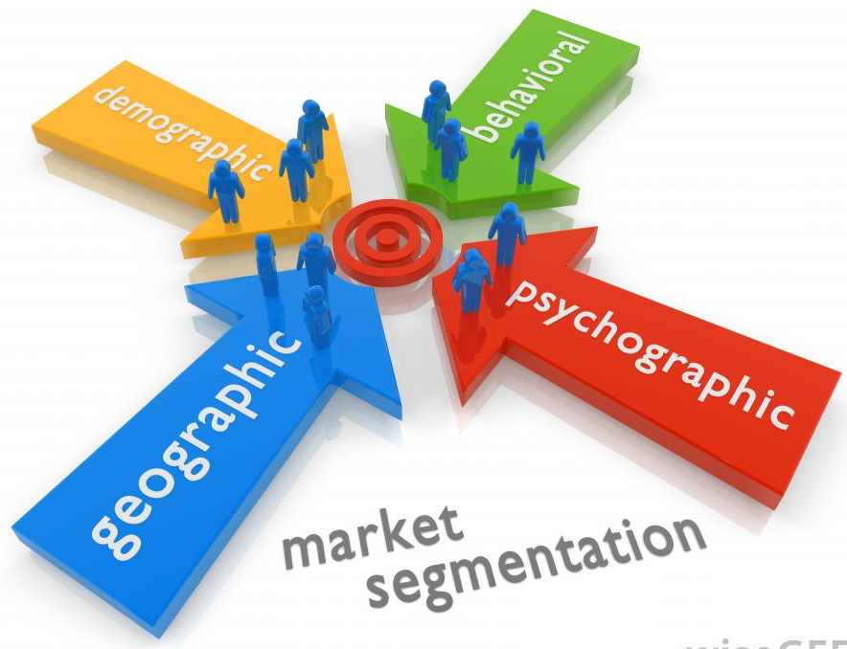
Dividing the market on relevant dimensions
A priori or post hoc?
Determining Dimensions
Prior Research, Purchase Trends, Managerial Experience & Judgment
Bases for Segmentation
Geographic
Demographic
Behavior
Use
Benefits Sought
Psychographic
Geodemographic
Etc…

Slide 8

Demographic Segmentation
Income
Population
Age distribution
Gender
Education
Occupation
What are the trends?

Slide 9
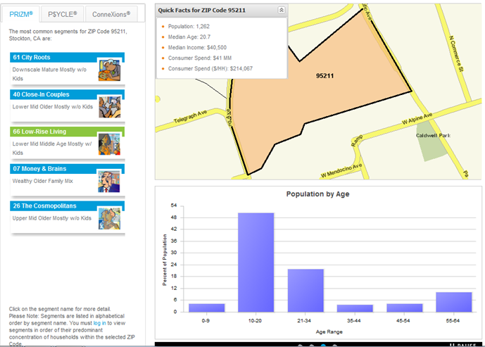

Slide 10
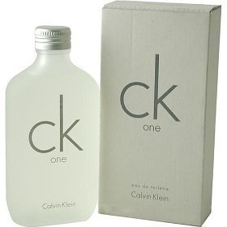
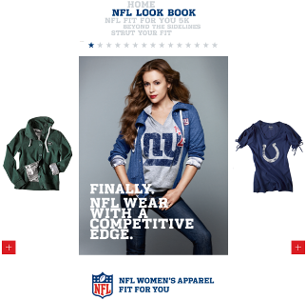

Gender Segmentation
Notes:
http://www.huffingtonpost.com/2011/10/28/axe-deodorant-ad-banned-angels_n_1064150.html

Slide 11
Psychographic Segmentation
Grouping in terms of people’s attitudes, values, and lifestyles.
Activities- work, hobbies, vacations
Interests- family, job, community
Opinions- social issues, politics, business
Notes:
VALS Survey: http://www.strategicbusinessinsights.com/vals/presurvey.shtml

Slide 12
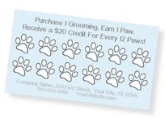
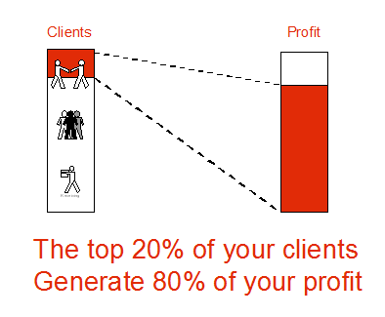
Behavioral Segmentation
Focus on whether people purchase a product or not, how much, and how often they use it
ex. Occasion & Loyalty
usage rates: heavy, medium, light, and non-user.
user status: potential users, non-users, ex-users, regulars, first-timers, and users of competitors’ products.
80/20 rule!!!

Slide 13

Benefit Segmentation
Based on understanding the problem a product solves, the benefit it offers, or the issue it addresses

Slide 14


Take Away for Today
What’s the segment?
Look beyond the now… Spot the trends

Slide 15

Next Class
Chapter 9: STP cont…
Wednesday February 22.
Library Database Session w/ Jack Schroeder
Exam 1: Monday February 20th

